Slide 1
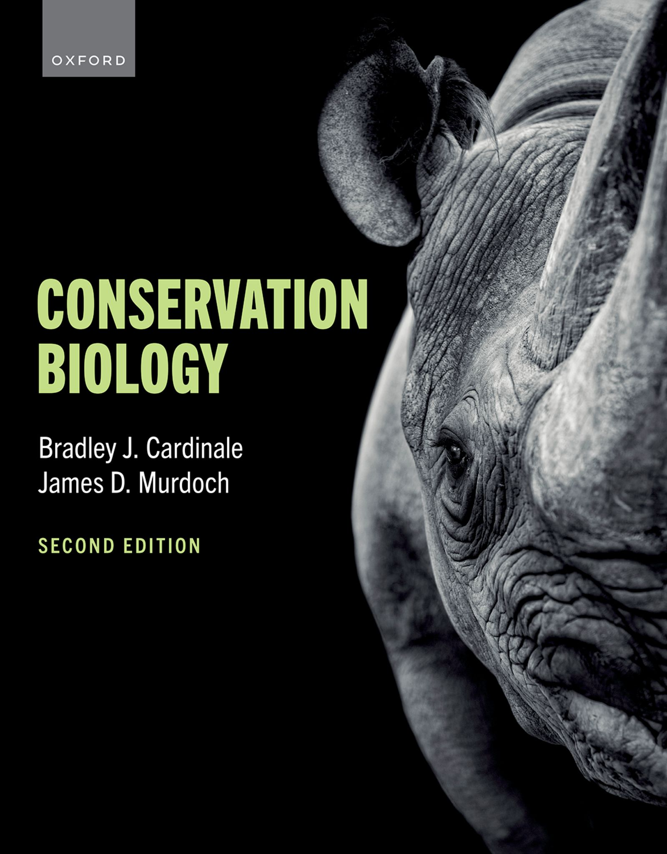
CONSERVATION BIOLOGY
By Bradley J. Cardinale and James D. Murdoch

Slide 2
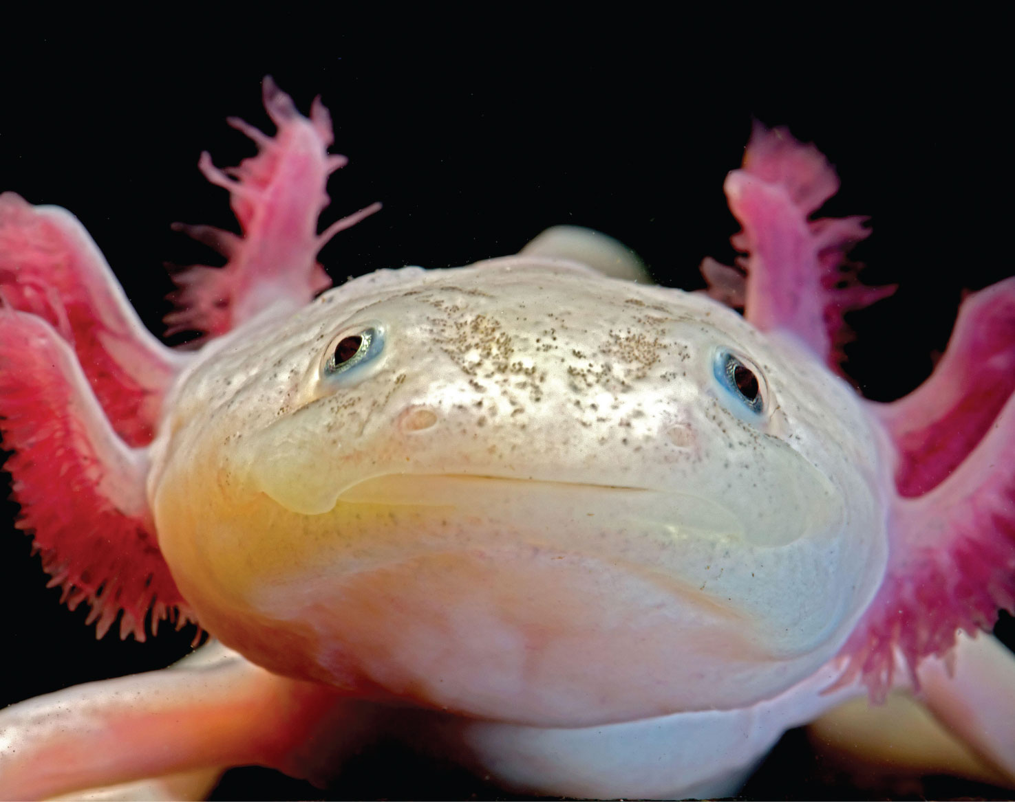
2
Notes:
The axolotl (Ambystoma mexicanum) is a salamander that has been widely used in scientific research because of their ability to regenerate limbs, gills, and parts of their eyes and brains. The species was once abundant in lakes underlying what is now Mexico City, but it is now considered Critically Endangered as a result of urbanization in Mexico City, water pollution, and the introduction of invasive predators like tilapia and perch. An estimated 50 to 1,000 adult individuals remain in nature.

Slide 3
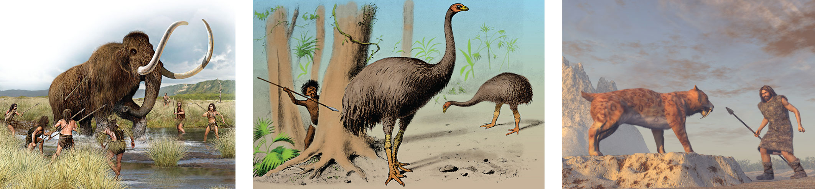
Figure 2.1 Human impacts on biodiversity are not just a modern phenomenon.
Notes:
Figure 2.1 Human impacts on biodiversity are not just a modern phenomenon. Expansion of hunter-gatherer societies was a dominant driver of the extinction of megafaunal species, including the woolly mammoth from Arctic and northern lands; many of the flightless birds, like the moa, from New Zealand; and the saber-toothed cats from Europe and Asia.

Slide 4
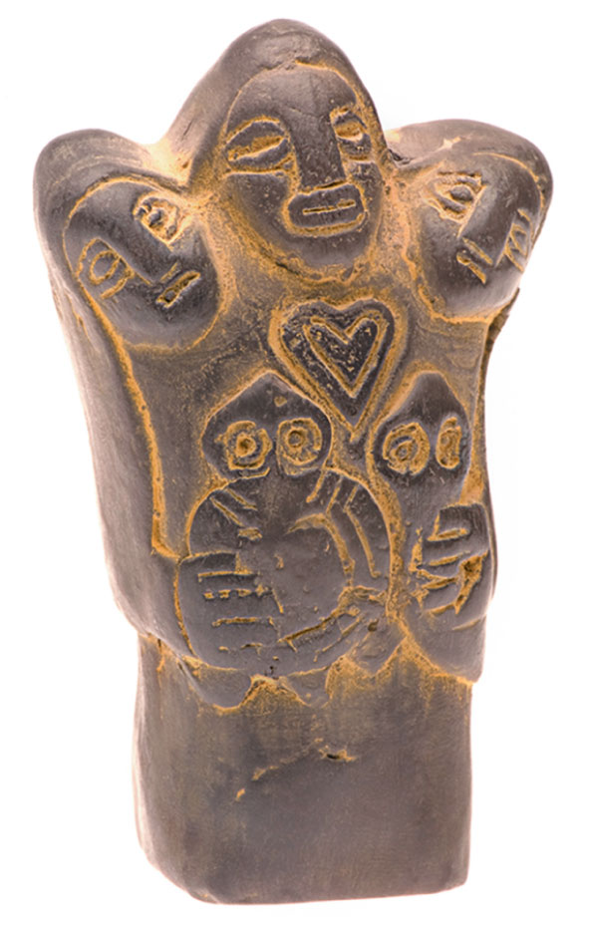
Figure 2.2 Many traditional societies espoused conservationist ideals in their belief systems.
Notes:
Figure 2.2 Many traditional societies espoused conservationist ideals in their belief systems. Depicted here is Pachamama—the earth/time mother of nature revered by Indigenous people of the Andes. In Inca mythology, she is a fertility goddess who presides over planting and harvesting and has the power to sustain life on Earth.

Slide 5
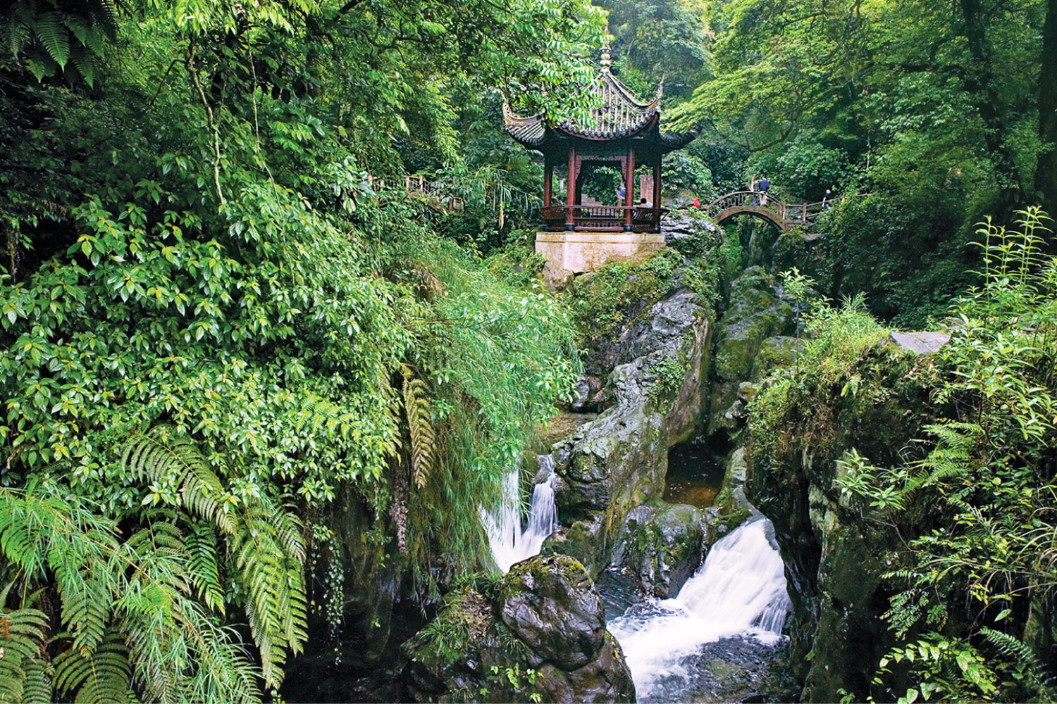
Figure 2.3 The Qingyin Pavilion is located in Mount Emei, which is one of China’s Four Sacred Buddhist Mountains that are regarded as places of enlightenment.
Notes:
Figure 2.3 The Qingyin Pavilion is located in Mount Emei, which is one of China’s Four Sacred Buddhist Mountains that are regarded as places of enlightenment. The pavilion is built on an outcrop in the middle of a fastflowing stream so one can appreciate nature’s music.

Slide 6
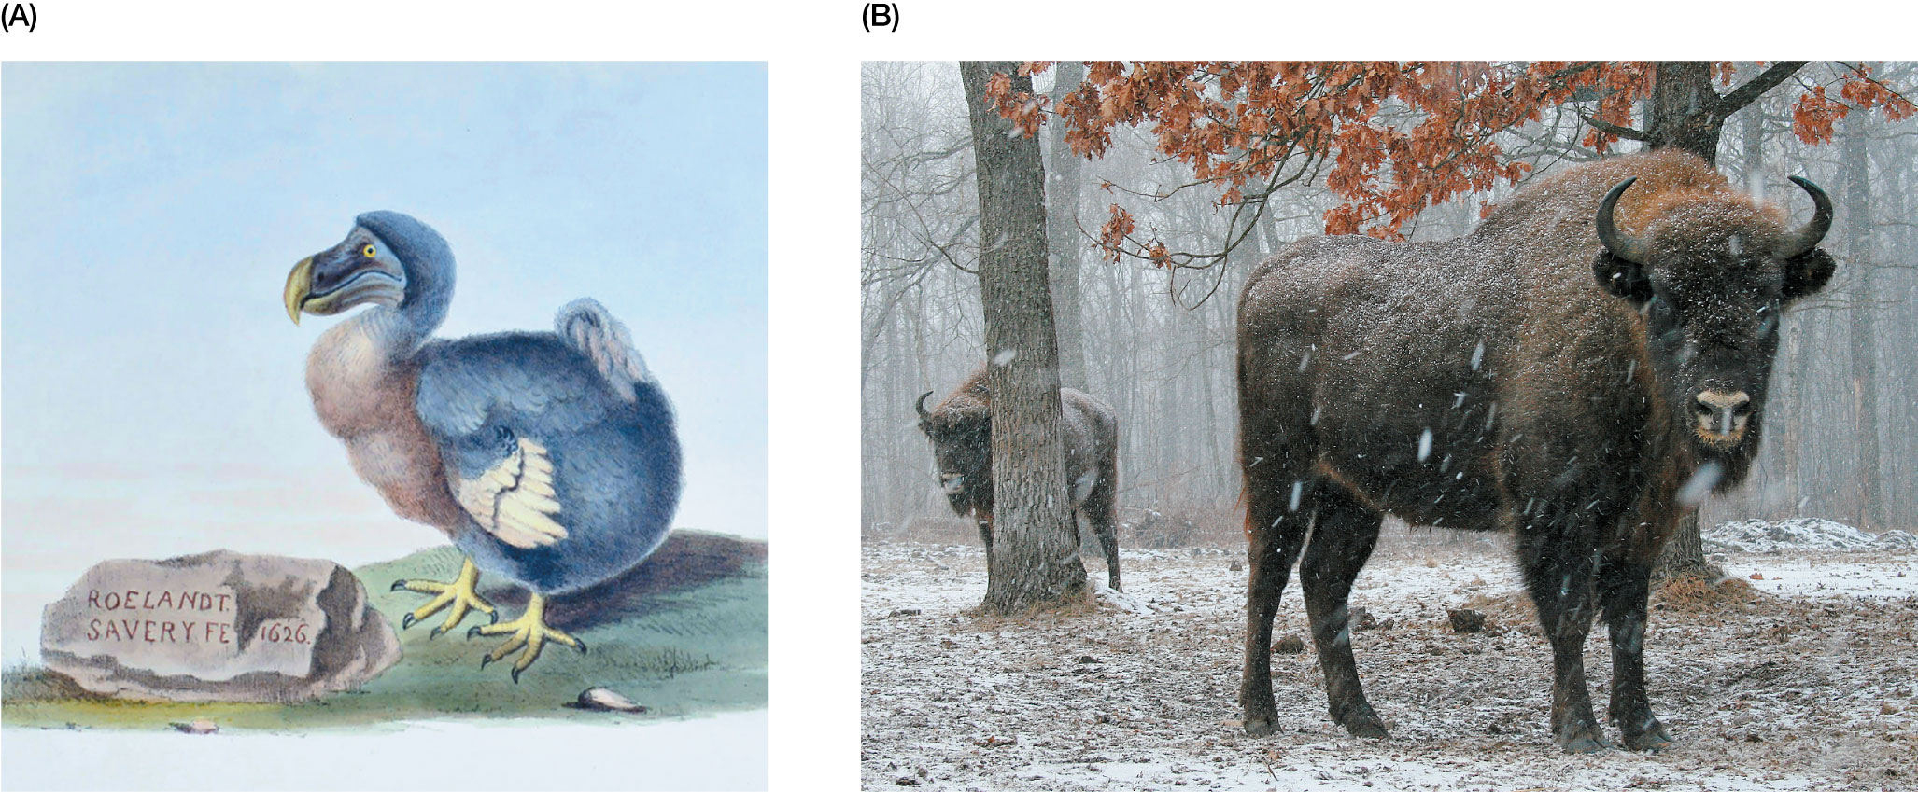
Figure 2.4 (A) Roelandt Savery’s figure of the dodo in his picture of the fall of Adam, in the Royal Gallery at Berlin.
Notes:
Figure 2.4 (A) Roelandt Savery’s figure of the dodo in his picture of the fall of Adam, in the Royal Gallery at Berlin. This illustration was painted using a live dodo (Raphus cucullatus) that was brought to Europe in the early seventeenth century, before the species went extinct. (B) One of Europe’s first nature reserves was established to protect the European bison (Bison bonasus) in Poland.

Slide 7
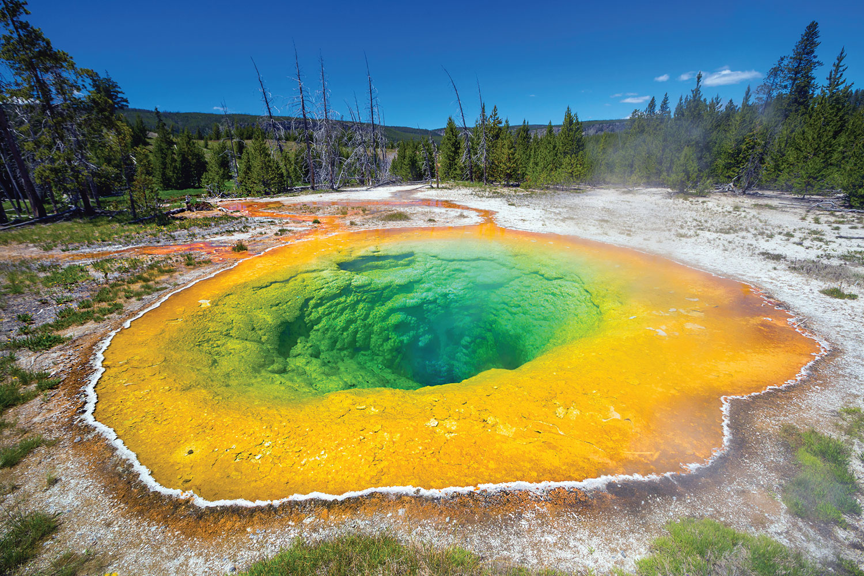
Figure 2.5 The astounding beauty and unique geothermal features of Yellowstone contributed to it becoming the first national park in the United States.
Notes:
Figure 2.5 The astounding beauty and unique geothermal features of Yellowstone contributed to it becoming the first national park in the United States. The unique thermophilic (heat-loving) bacteria later discovered in these hot springs produced the enzymes that led to a modern revolution in genetic engineering and biotechnology.

Slide 8
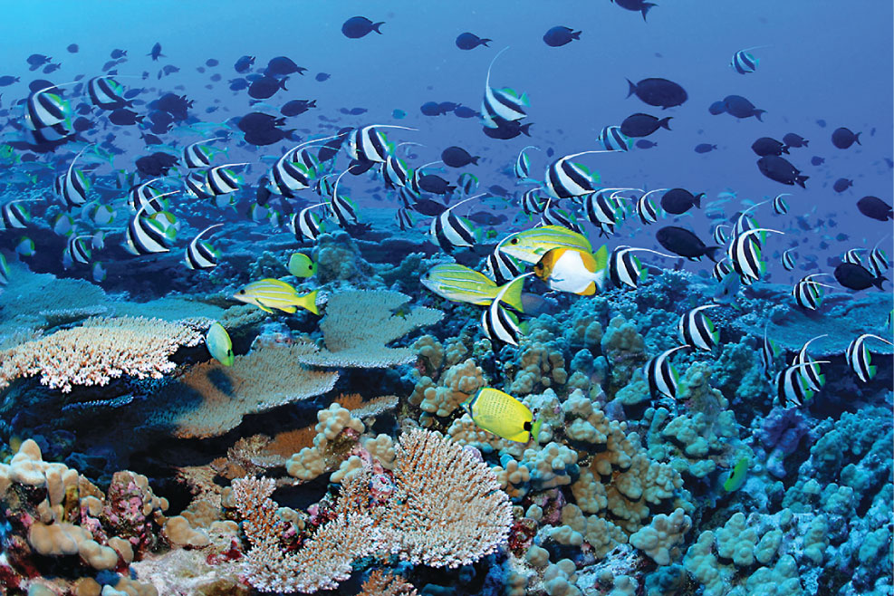
8
Notes:
The Papahānaumokuākea Marine National Monument is a World Heritage Site that was formed in 2000. It is one of 10 very large marine protected areas in the world.

Slide 9
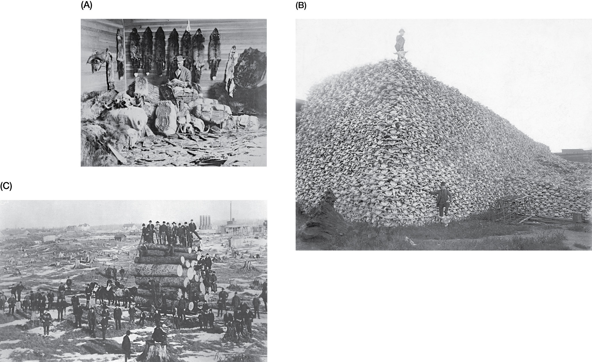
Figure 2.6 Examples of overexploitation of nature by white European colonists:
Notes:
Figure 2.6 Examples of overexploitation of nature by white European colonists: (A) Fur trader in Fort Chipewyan, Northwest Territories, in the 1890s. (B) Man stands atop a pile of buffalo skulls. (C) Logging around the Great Lakes from the 1850s through the 1880s led to clear-cutting of whole forests from the landscape.

Slide 10
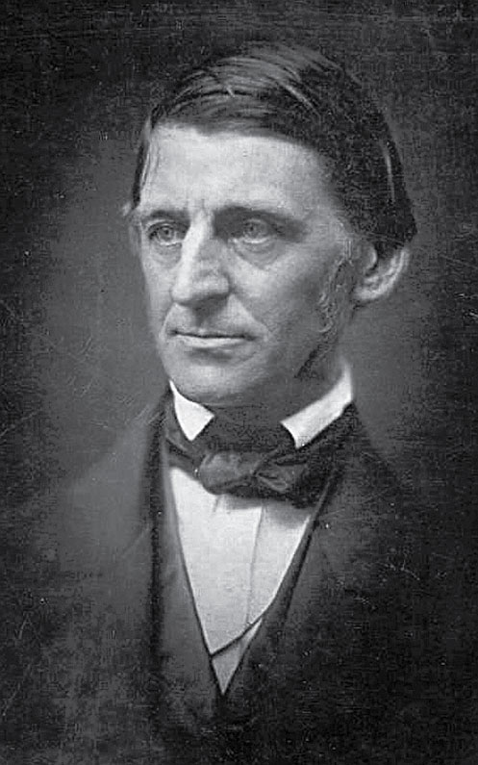
10
Notes:
R. W. Emerson

Slide 11
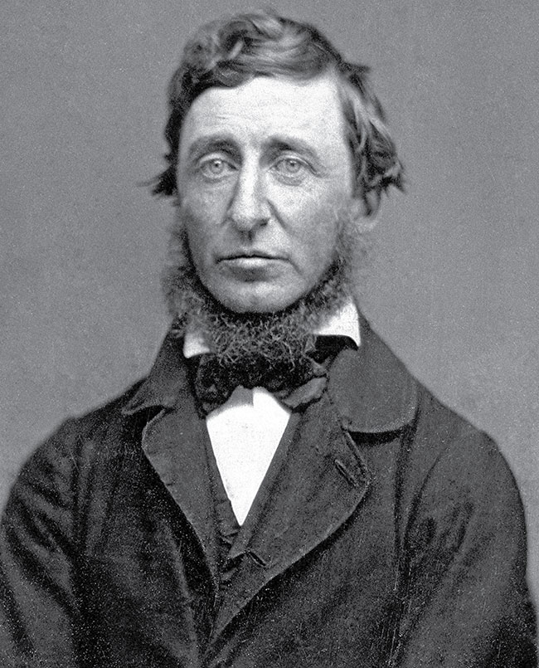
11
Notes:
H. D. Thoreau

Slide 12
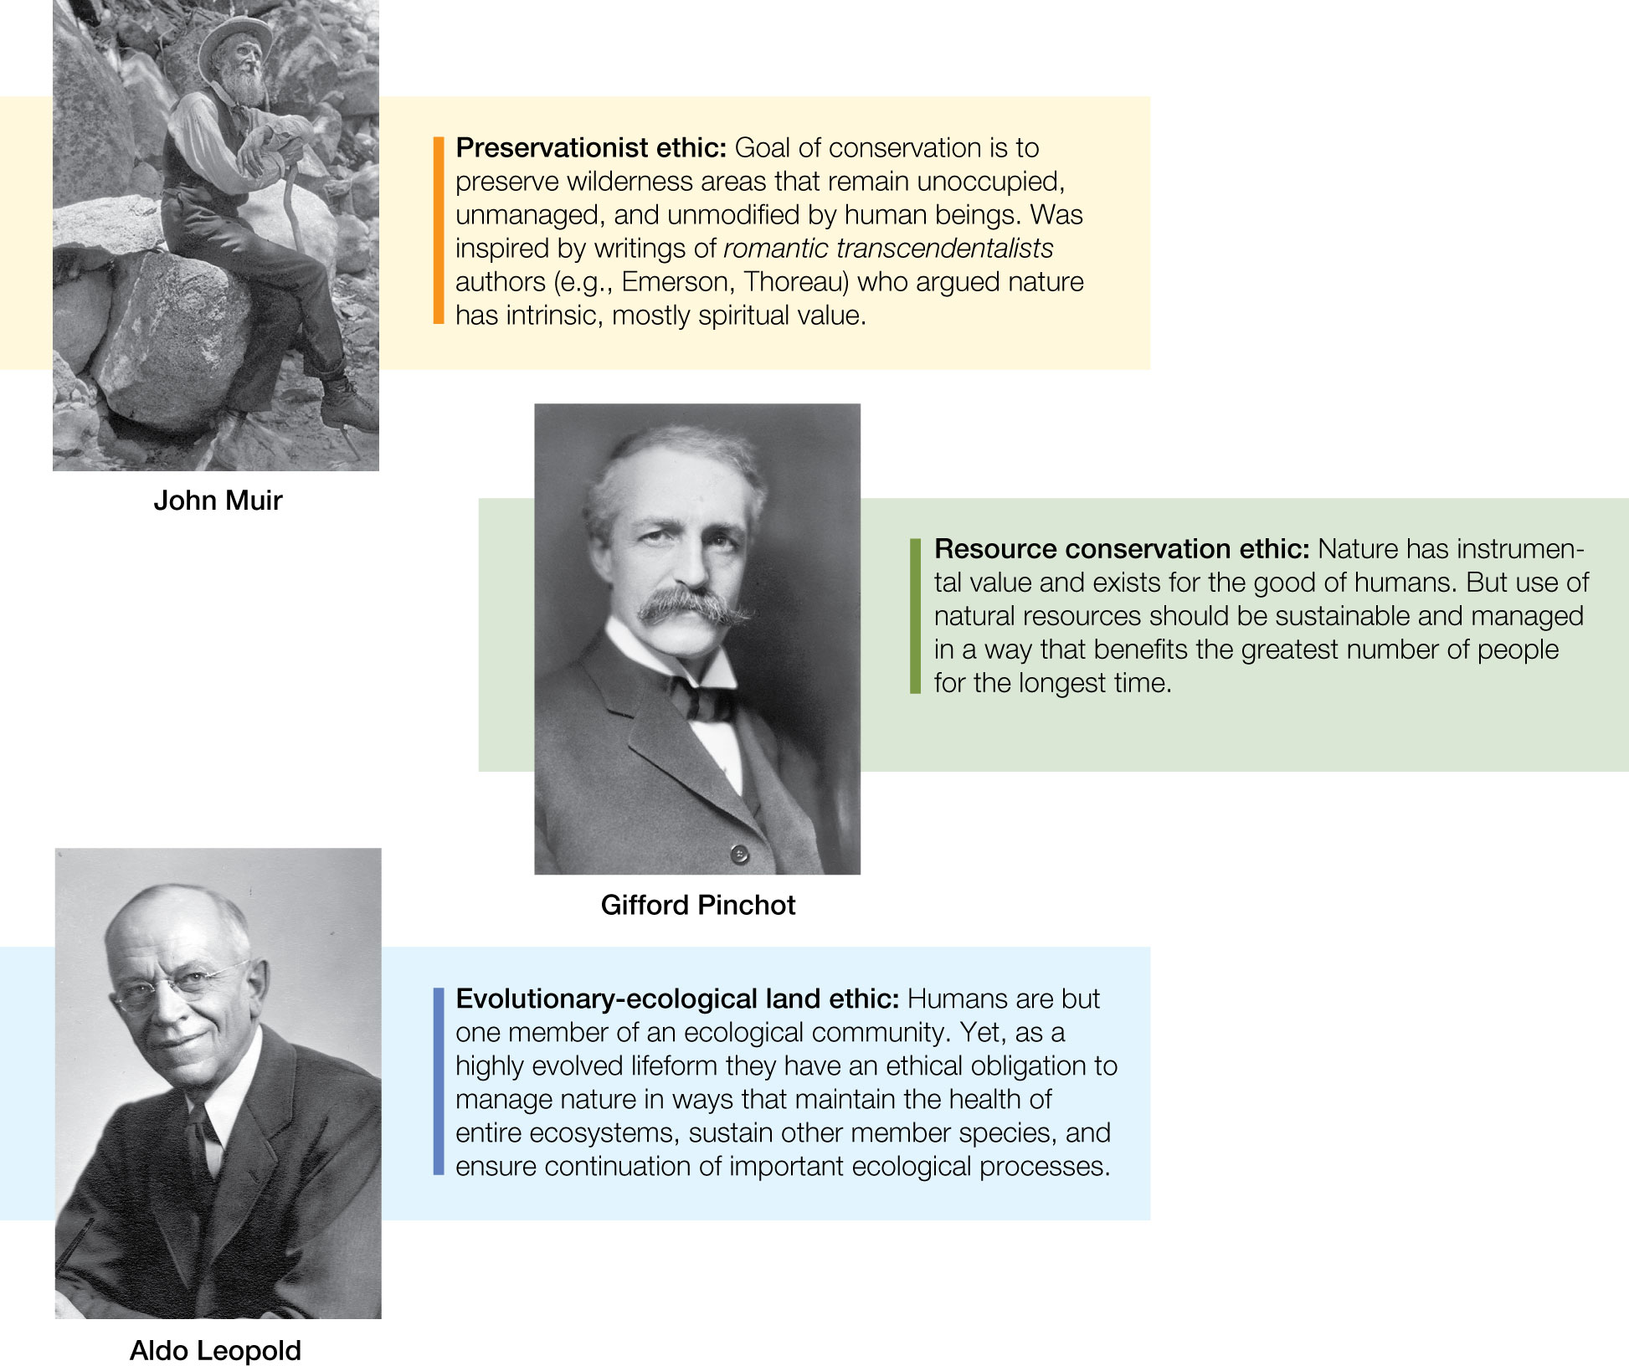
Figure 2.7 Summary of three conservation ethics that underlie modern conservation initiatives and form the basis for many policies and approaches used by conservation agencies and organizations throughout the world.
Notes:
Figure 2.7 Summary of three conservation ethics that underlie modern conservation initiatives and form the basis for many policies and approaches used by conservation agencies and organizations throughout the world.

Slide 13
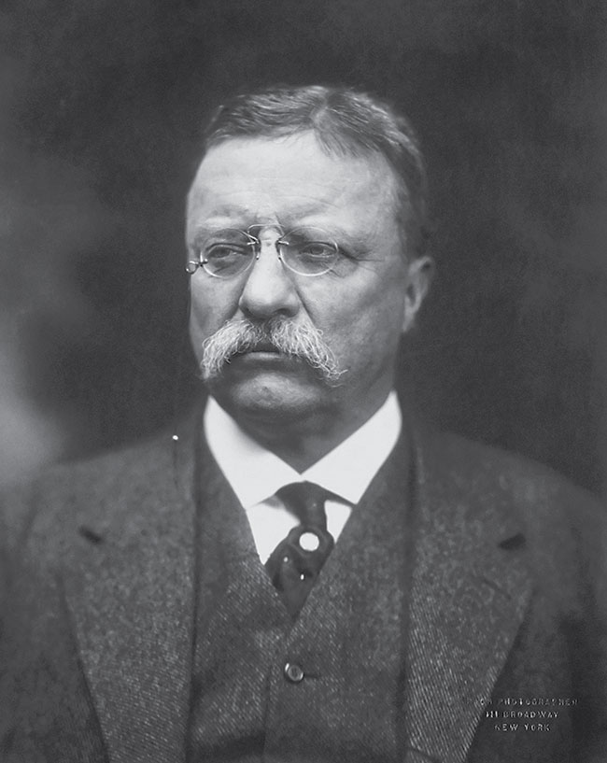
13
Notes:
Teddy Roosevelt

Slide 14
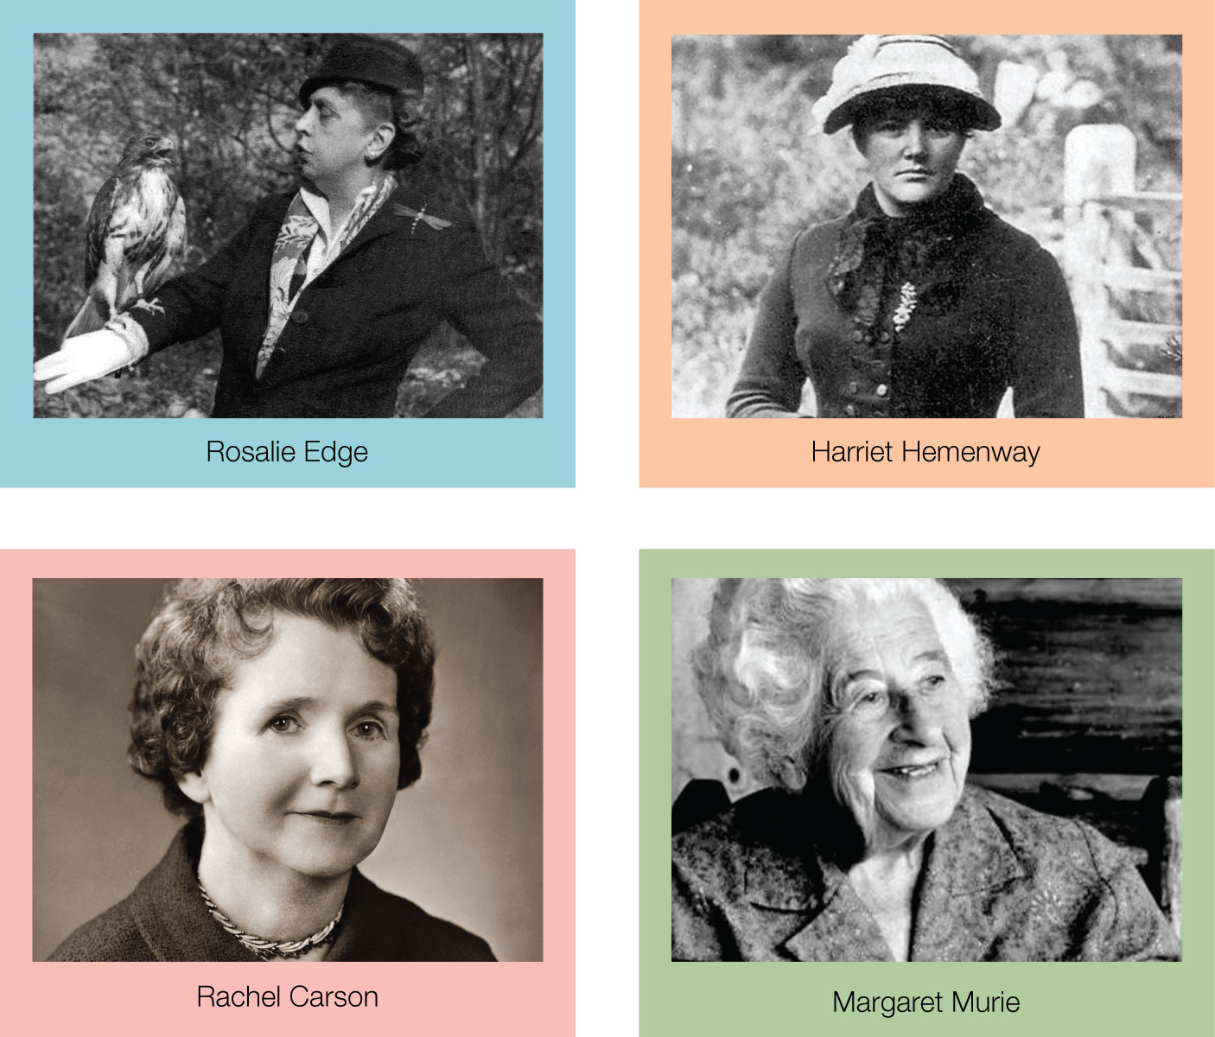
14

Slide 15
TABLE 2.1 Examples of key environmental disasters that helped trigger the modern environmental movement and formation of conservation biology as a global discipline
Year | Disaster | Description
1952 | London’s Great Smog | Thousands died and 100,000 fell ill after a blanket of smog covered London for five days in 1952. Cold weather combined with windless conditions allowed airborne nitrogen oxides, sulfur dioxide, and soot from coal burning to form a thick layer of smog over the city. Recent research has shown that 12,000 premature deaths can be partially attributed to this smog.
1953 | Love Canal | In the 1940s, the Hooker Chemical Company began dumping 21,000 tons of industrial waste into the Love Canal near Niagara Falls, New York. After the site was later sold and developed, Love Canal residents reported strange odors and blue goo bubbling into their basements. High rates of asthma, miscarriages, mental disabilities, and other health problems brought Love Canal into the spotlight in 1978, and subsequent surveys found that 56% of children born there between 1974 and 1978 had birth defects. New York State health commissioner David Axelrod called the incident a “national symbol of a failure to exercise a sense of concern for future generations.” The U.S. government soon after passed the Superfund law.
1954 | Bikini Atoll | Between 1946 and 1958, the United States detonated 23 nuclear devices at Bikini Atoll. In 1954, one of those detonations exposed 23 crew members of the Japanese fishing vessel Lucky Dragon 5 to radioactive fallout, leading to acute radiation sickness. Years of nuclear testing so contaminated the soil and water at Bikini Atoll that the site was ultimately rendered a nuclear wasteland, with radiation levels in 2016 continuing to be above the established safety levels for human habitation. The United States ultimately paid the islanders and their descendants $125 million in compensation for damage caused by the nuclear testing program and displacement from their home island.
1956 | Minamata disease | In 1956, Chisso Corporation’s industrial wastewater containing highly toxic methylmercury was released into Minamata Bay and the Shiranui Sea. As the mercury bioaccumulated in shellfish and fish that were eaten by the local populace, individuals began to show signs of neurological disorders, including numbness and difficulty seeing, hearing, and swallowing. Initial symptoms were followed by severe convulsions, coma, and eventual death, and 2,265 fatalities are recognized as a direct consequence of this pollution event.
1962 | DDT | After World War II, use of the pesticide dichlorodiphenyltrichloroethane (DDT) was rampant. DDT was promoted as a wonder chemical: the solution to pest problems large and small. But in her groundbreaking 1962 book Silent Spring, Rachel Carson highlighted the dangers of DDT and the disastrous consequences of the indiscriminate use of insecticides on the environment and its wildlife. Carson’s book, and testimony before the U.S. Congress, helped trigger the establishment of the U.S. Environmental Protection Agency, which subsequently banned the use of DDT.
Notes:
TABLE 2.1 Examples of key environmental disasters that helped trigger the modern environmental movement and formation of conservation biology as a global discipline

Slide 16
TABLE 2.1 (Continued)
Year | Disaster | Description
1969 | Santa Barbara oil spill | The third-largest oil spill in U.S. history fouled the Santa Barbara Channel off the coast of California. Prominent media coverage, with pictures of seabirds, dolphins, sea lions, and elephant seals covered in oil, sparked public outrage.
1969 | Cuyahoga River | After being polluted for decades with industrial waste, an oil slick on Cleveland’s Cuyahoga River caught fire. A subsequent picture in Time magazine of flames leaping from the water to engulf a ship helped catalyze the environmental movement in the United States.
1976 | Seveso disaster | In July 1976, an explosion at a chemical manufacturing plant north of Milan, Italy, released tetrachlorodibenzo- p-dioxin into the atmosphere, adversely affecting the nearby town of Seveso. Shortly thereafter, 3,300 animals died and many more were euthanized to prevent the spread of contamination into the food chain. Children were hospitalized with skin inflammation, and nearly 500 people were found to have skin lesions.
1978 | Portsall oil spill | A huge crude oil tanker, the Amoco Cadiz, ran aground on Portsall Rocks off the coast of Brittany, France, split into three parts, and leaked 1,604,500 barrels of crude oil. The spill contributed to the largest loss of marine life ever registered from an oil spill. Millions of dead sea urchins and mollusks washed ashore after the event. More than 20,000 dead birds were recovered, and dead oysters were approximated at 9,000 tons.
Notes:
TABLE 2.1 Examples of key environmental disasters that helped trigger the modern environmental movement and formation of conservation biology as a global discipline

Slide 17
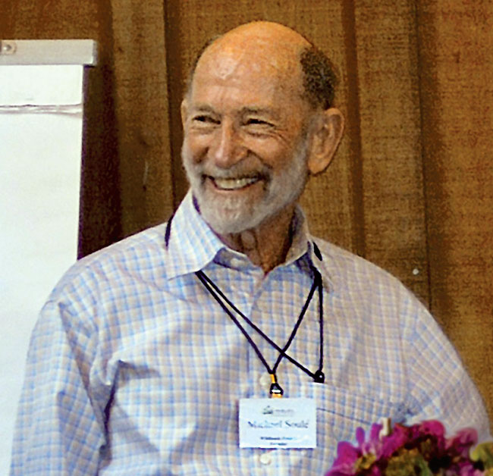
17
Notes:
Michael Soulé

Slide 18
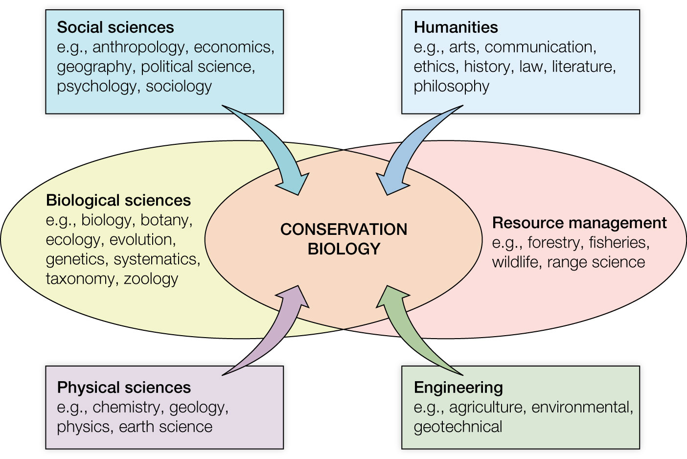
Figure 2.8 The growing interdisciplinary nature of conservation biology.
Notes:
Figure 2.8 The growing interdisciplinary nature of conservation biology. Though founded in the disciplines of biological sciences and natural resource management, conservation has expanded to include the social sciences, humanities, physical sciences, and engineering.

Slide 19
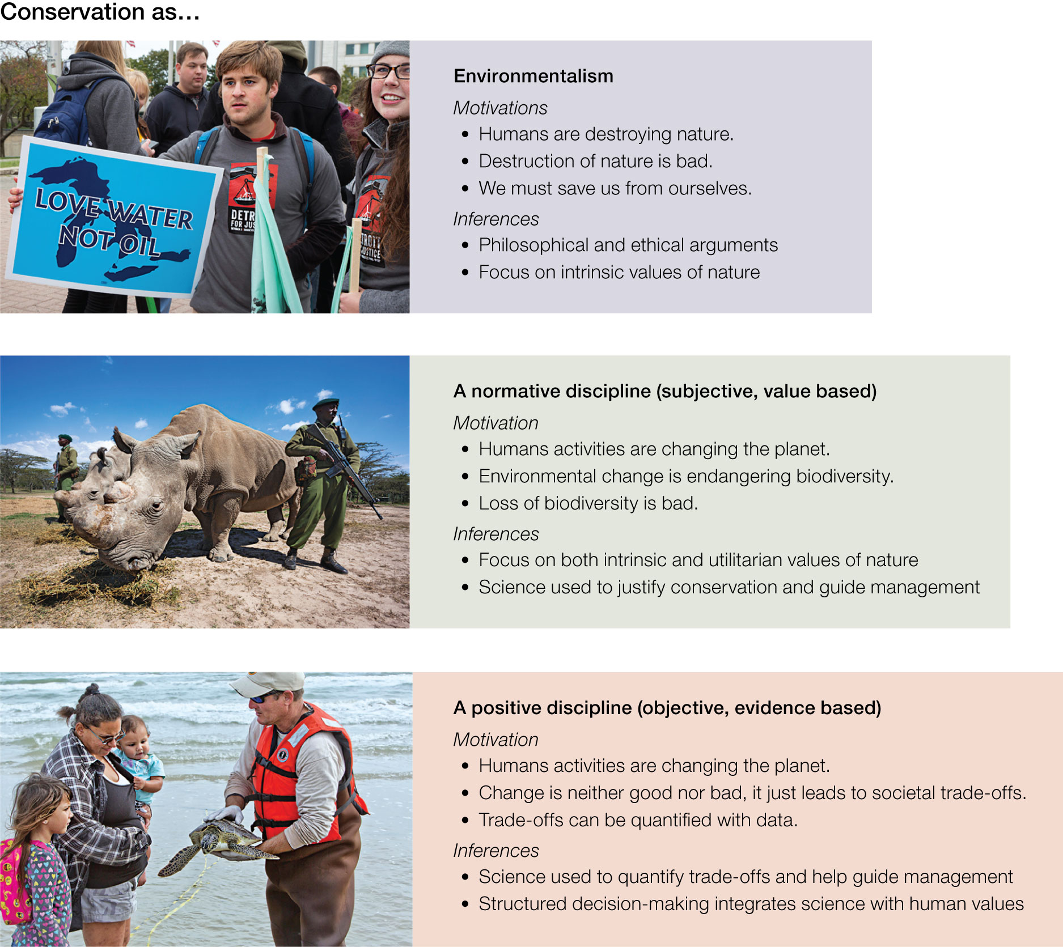
Figure 2.9 Three distinct views of conservation. (Top) Conservation as environmentalism. (Middle) Conservation as a normative discipline. (Bottom) Conservation as a positive discipline.
Notes:
Figure 2.9 Three distinct views of conservation. (Top) Conservation as environmentalism. (Middle) Conservation as a normative discipline. (Bottom) Conservation as a positive discipline.

